Slide 1
The Year in Numbers
Dr. Jason Campbell, a personal scorecard
Research, education, fitness, and family, reviewed February 2026
322
28
No. 2
1663
patients enrolled
CME hours
tennis ladder
peak chess rating

Slide 2
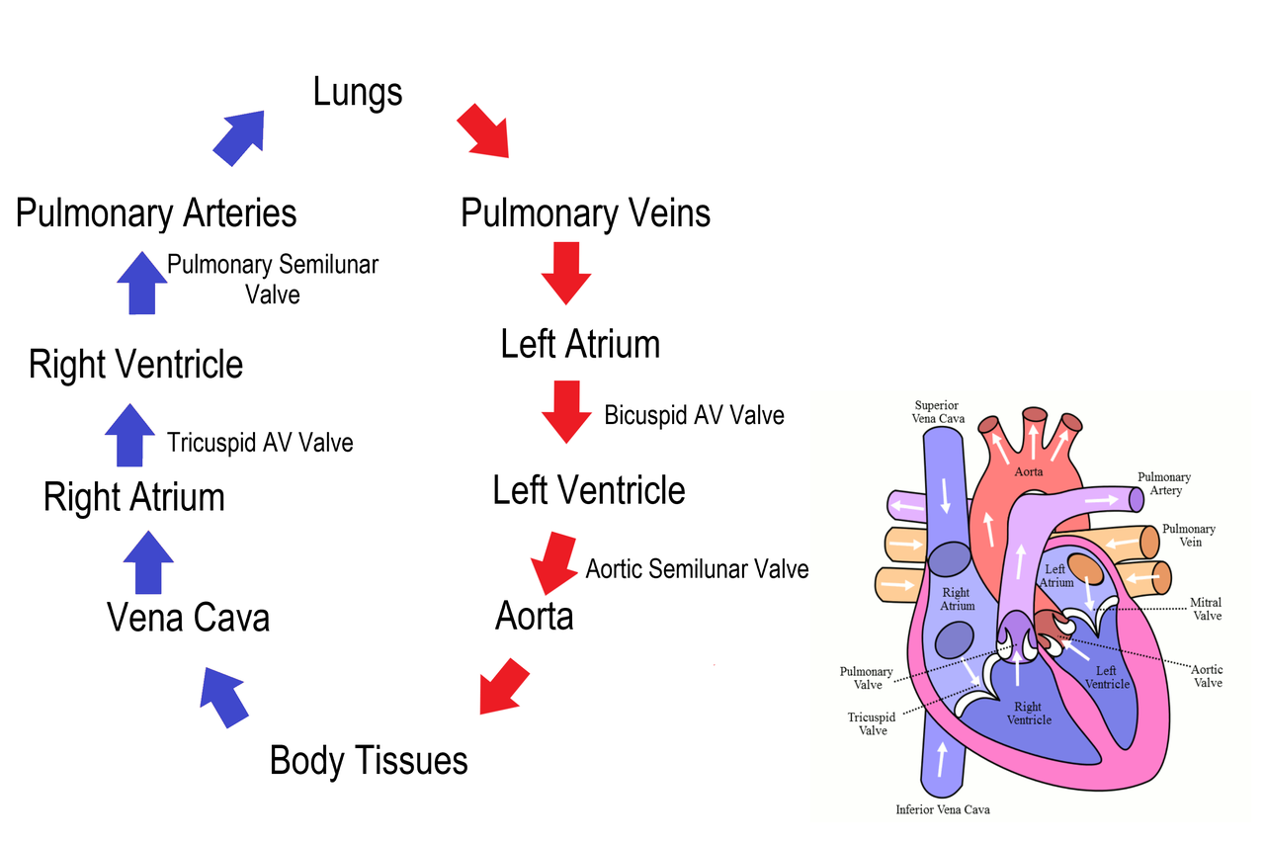
Research, Aortic Valve Study
Toward 500 patient target
64%
Manuscript shell ready for the Journal of Interventional Practice, target October 15. IRB approved through January 2027.
Enrollment by site, 322 of 500 target

Slide 3
Continuing Education
Progress to the 50 hour requirement
28 of 50 hours by December 31
56%
Date | Activity | Hrs
Jan 18 | Interventional Update | 6
Feb 6 | Structural Heart Symposium | 7.5
Feb 24 | Antiplatelet Grand Rounds | 1.5
Feb 27 | TAVR Outcomes Live Course | 6
28 hours logged by category

Slide 4
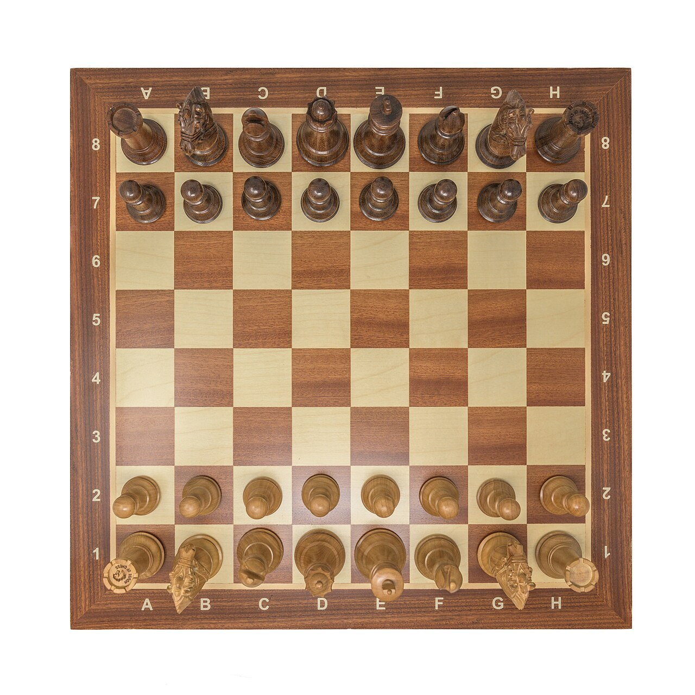
Off the Clock
Running three mornings, tennis three mornings, twenty minutes at the piano on weeknights, and brisket on Saturday. Teaching Emily the openings first.
Online chess rating, Sicilian Defense, around 1650

Slide 5
Family Milestones Ahead
When | Who | Milestone
October 2026 | Kyle | Step 2 examination, result late month
October 12 | Dorothy | Birthday, quiet family dinner
October 20 | Brian | 48th birthday, family call
November 14 to 16 | Jason | Heart Conference, chairing sessions
December 3 | Kyle | Birthday
January 22 | Emily | Birthday
February 9 | Karen | Birthday, dinner at Orsay

Slide 6
A good year, measured.
Precision in the lab, discipline in the routine, and Friday dinner that never gets scheduled over.
The Year in Numbers | Personal scorecard, February 2026

